Slide 1
编译原理
Lecture 6：Lexical Analysis III
词法分析III
2019年秋季学期

Slide 2
Regular Expression→DFA (Directly)
Construct a DFA directly from a regular expression, without constructing an intermediate NFA
The resulting DFA may have fewer states than the DFA constructed via an NFA
Commonly used

Slide 3
Basic Idea
用位置的集合来表示状态
例如 (a|b)*abb
位置： 1 2 3 4 5
a
1,2,3,4
…
start→
1,2,3
b

Slide 4
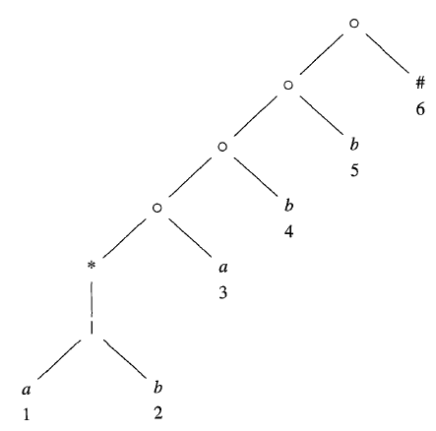
Syntax Tree
用’#’表示正则表达式的结束
构造正则表达式的语法树
例如(a|b)*abb#的语法树如右
叶节点下的数字表示位置
语法树的每个结点代表一个子表达式

Slide 5
语法树的相关函数
(a|b)*abb#
nullable(n): nullable(n) is true for a syntax-tree node n if and only if the subexpression represented by n has є in its language.
例如：右图，结点n1代表子表达式(a|b)*a，nullable(n1) = false，而结点n2代表(a|b)*，nullable(n2) = true
n1→
n2→

Slide 6
语法树的相关函数
firstpos(n): firstpos(n) is the set of positions in the subtree rooted at n that correspond to the first symbol of at least one string in the language of the subexpression rooted at n.
例如，右图中，n代表(a|b)*a，
firstpos(n) = {1,2,3}
n→

Slide 7
语法树的相关函数
lastpos(n): lastpos(n) is the set of positions in the subtree rooted at n that correspond to the last symbol of at least one string in the language of the subexpression rooted at n.
例如，右图中，n代表(a|b)*a，lastpos(n) = {3}
n→

Slide 8
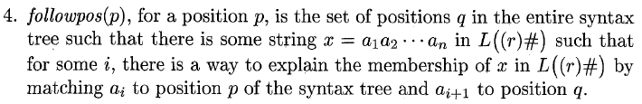
语法树的相关函数
例如，右图中，
followpos(1) = {1,2,3}

Slide 9
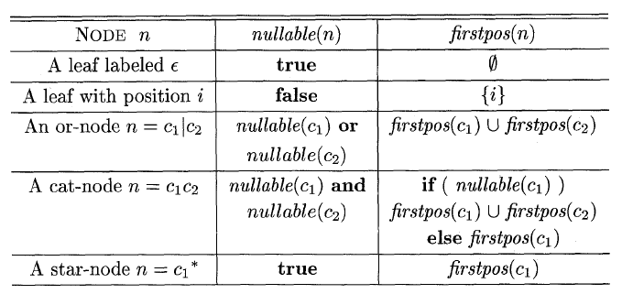
函数的计算方法

Slide 10
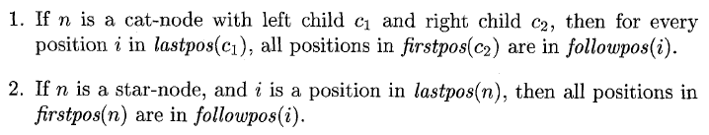
计算followpos
Two rules:

Slide 11
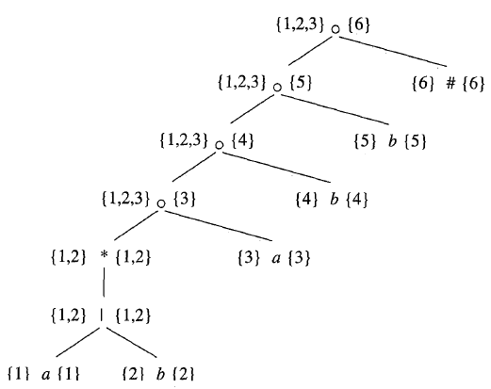
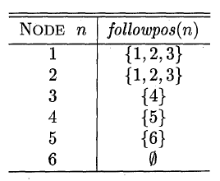
计算followpos的例子
position i
followpos(i)

Slide 12
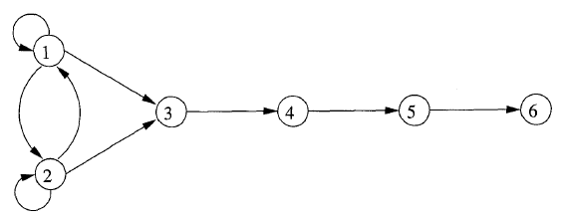
用有向图表示followpos函数
position i
followpos(i)
可表示为

Slide 13
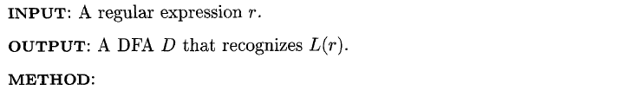
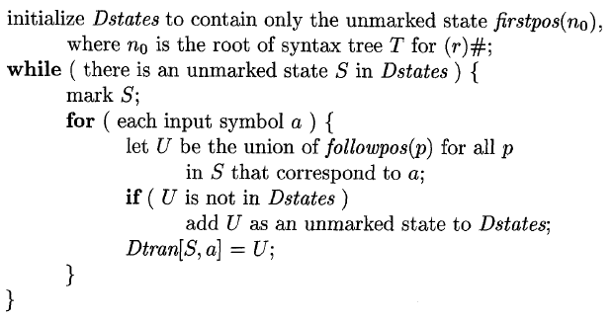
转换算法

Slide 14
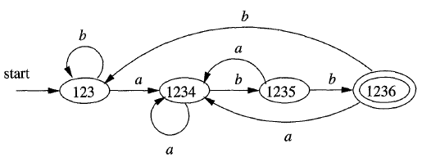
例子
例如 (a|b)*abb#
位置： 1 2 3 4 5 6
运用前述算法得

Slide 15
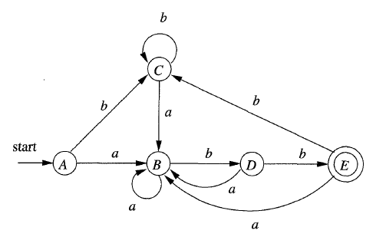
比较
上图比下图少了一个状态
问题：如何使得DFA的状态数最少？

Slide 16
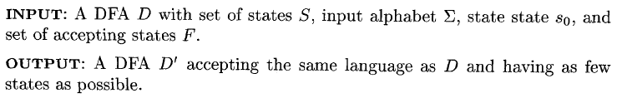
DFA的最小化

Slide 17
Basic idea

Slide 18
最小化算法 (划分部分)

Slide 19
最小化算法 (构造部分)

Slide 20
DFA最小化的例子

Slide 21
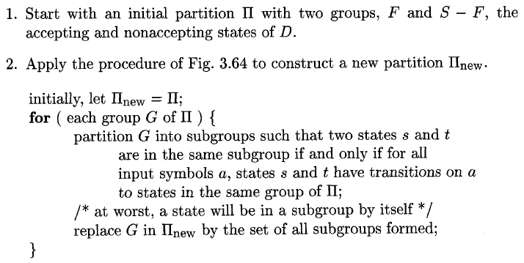

最小化DFA的算法

Slide 22

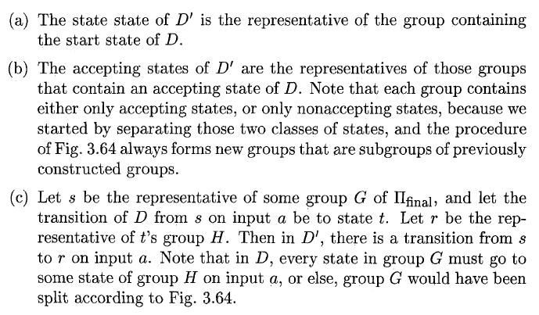
最小化DFA的算法（续）

Slide 23
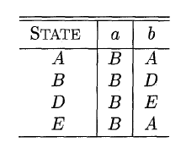
例子
最小化得

Slide 24
讨论
为什么上述最小化算法是正确的？
为什么合并不可区分状态依然得到等价的DFA？
为什么算法结束之后，在不同group中的状态一定是可区分的？而同一group中的状态一定是不可区分的？
算法的复杂度多少（字母表大小视为常数）？

Slide 25

正则表达式和有限自动机的局限性
“有限自动机无法计数”
例如，无法构造一个有限自动机接受语言
1:
2: 所有包含匹配括号的串，例如”((())())”
如何证明？
Notes:
Pumping lemma for regular languages

Slide 26
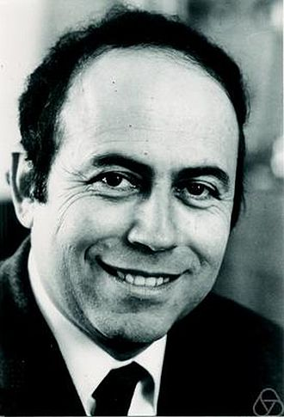
The pumping lemma
Let L be a regular language. Then there exists an integer p ≥ 1 depending only on L such that every string w in L of length at least p can be written as w = xyz (i.e., w can be divided into three substrings), satisfying the following conditions:
|y| ≥ 1,
|xy| ≤ p, and
xy^{n}z ∈ L for all n ≥ 0.
y is the substring that can be pumped (removed or repeated any number of times, and the resulting string is always in L). (1) means the loop y to be pumped must be of length at least one; (2) means the loop must occur within the first p characters. |x| must be smaller than p (conclusion of (1) and (2)), but apart from that, there is no restriction on xand z.
In simple words, for any regular language L, any sufficiently long word w (in L) can be split into 3 parts. i.e. w = xyz , such that all the strings xy^{n}z for n ≥ 0 are also in L.

Slide 27
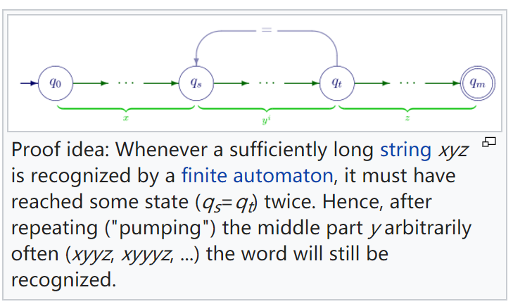
Proof of the pumping lemma

Slide 28
Use the pumping lemma to prove…
“有限自动机无法计数”
例如，无法构造一个有限自动机接受语言
1:
2: 所有包含匹配括号的串，例如”((())())”
There exists an integer p ≥ 1 depending only on L such that every string w in L of length at least p can be written as w = xyz (i.e., w can be divided into three substrings), satisfying the following conditions:
|y| ≥ 1,
|xy| ≤ p, and
xy^{n}z ∈ L for all n ≥ 0.
Notes:
Pumping lemma for regular languages

Slide 29
剩下的问题
理论：
正 则文法与正则表达式的等价性?
实践：
如何用正则表达式-> DFA的相关理论和算法来设计一个真正的词法分析器？

